Slide 1
Phonebook directory

Slide 2
modules
1.add contact
2.search contact
3.update contact
4.delete contact
5.display contact
6.statistics and file handling

Slide 3
requirements
1)HARDWARE : COMPUTER,4 GB RAM
2)SOFTWARE :C++ COMPILER

Slide 4
METHODOLOGY
1. Add Contact (Sorted Insertion)
2. Search Contact (Unified Search by Name/Phone)
3. Update Contact
4. Delete Contact
5. Display Contacts
6. Statistics & File Handling (Save/Load Binary Data)

Slide 5
ALGORITHM
1.START
2.LOAD DATA
3.DISPLAY MENU
4.PERFORM OPERATION
5.SAVE DATA
6.EXIT

Slide 6
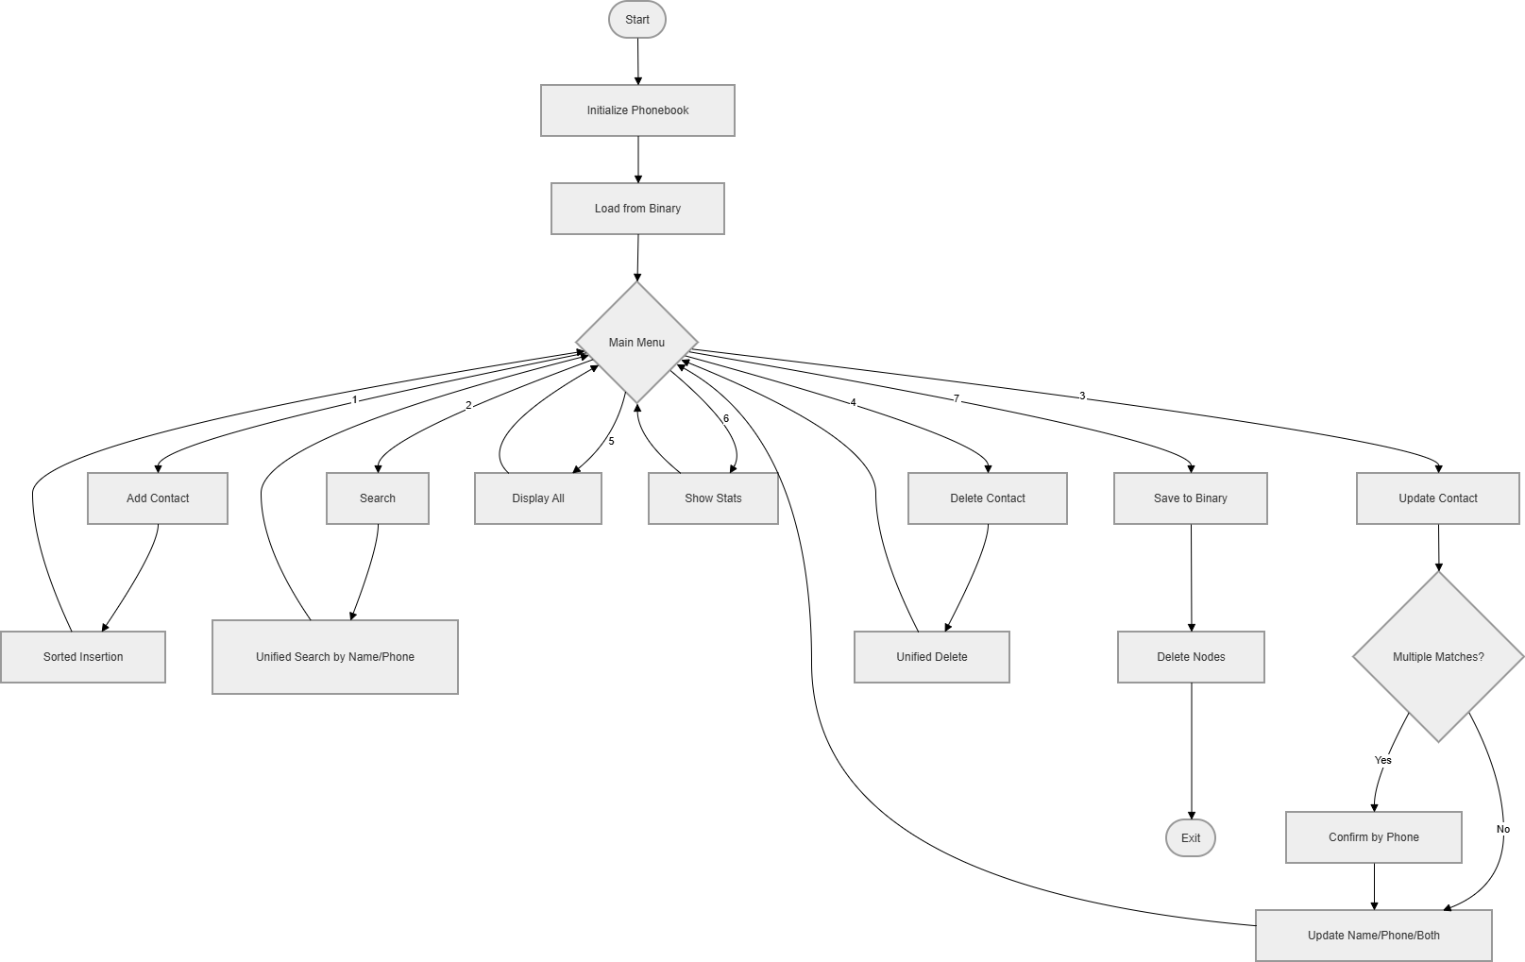
FLOW CHART:

Slide 7
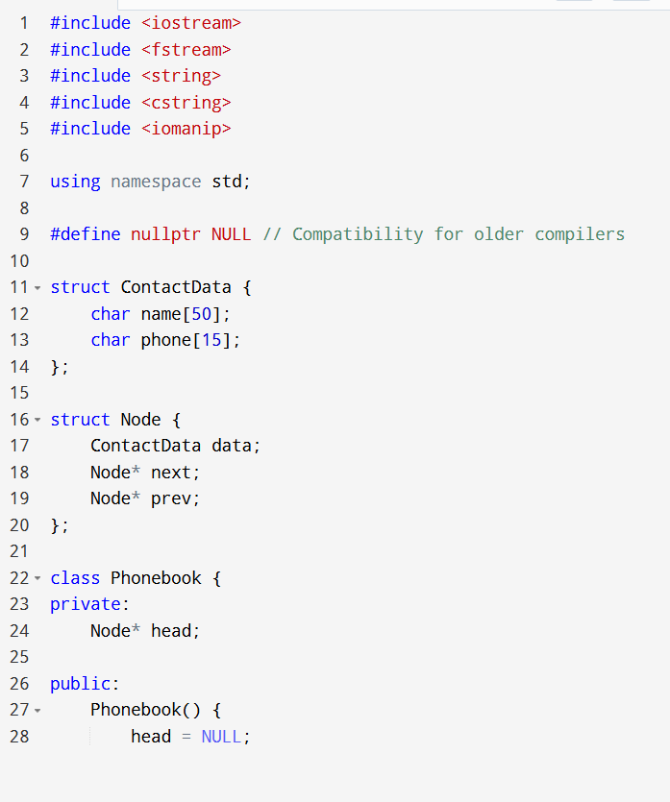
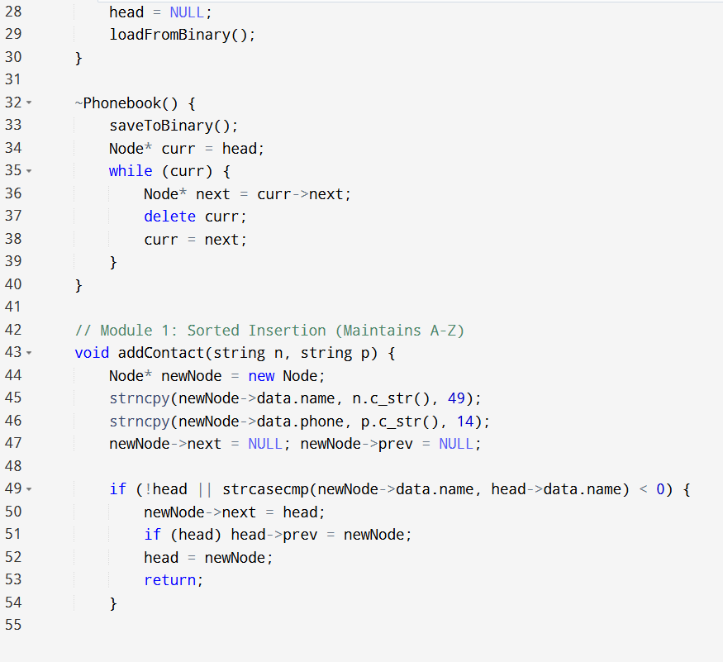

Slide 8
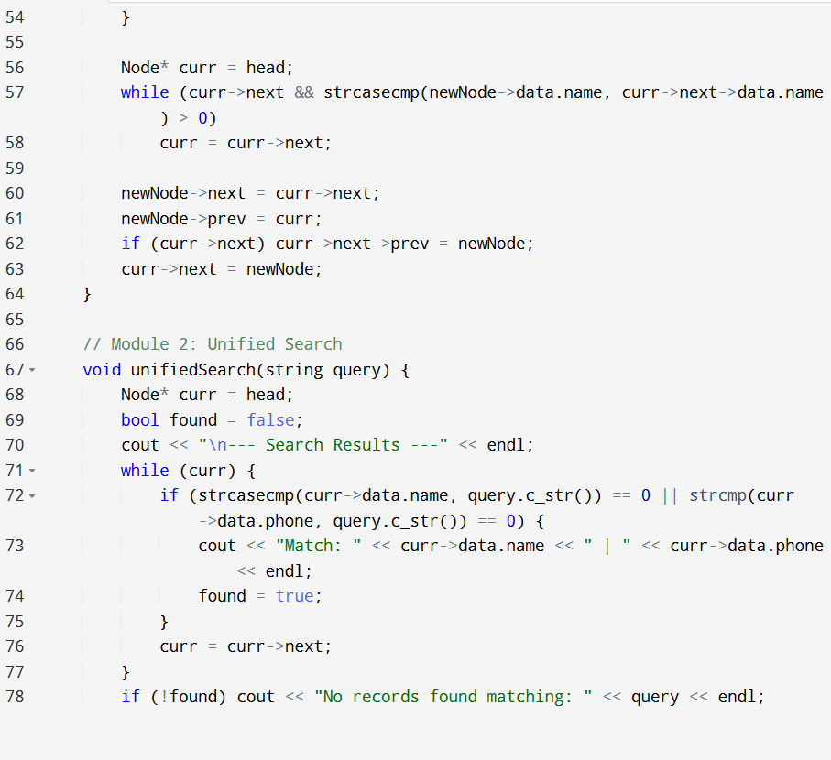
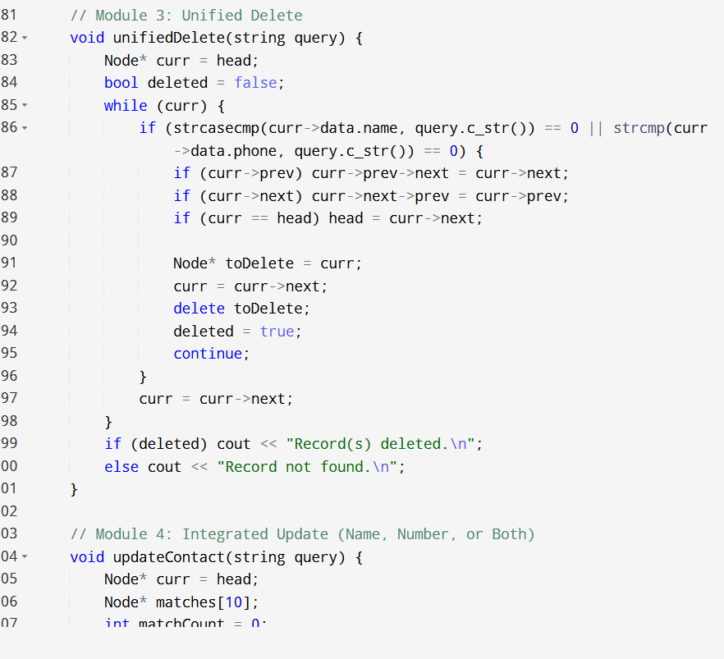

Slide 9
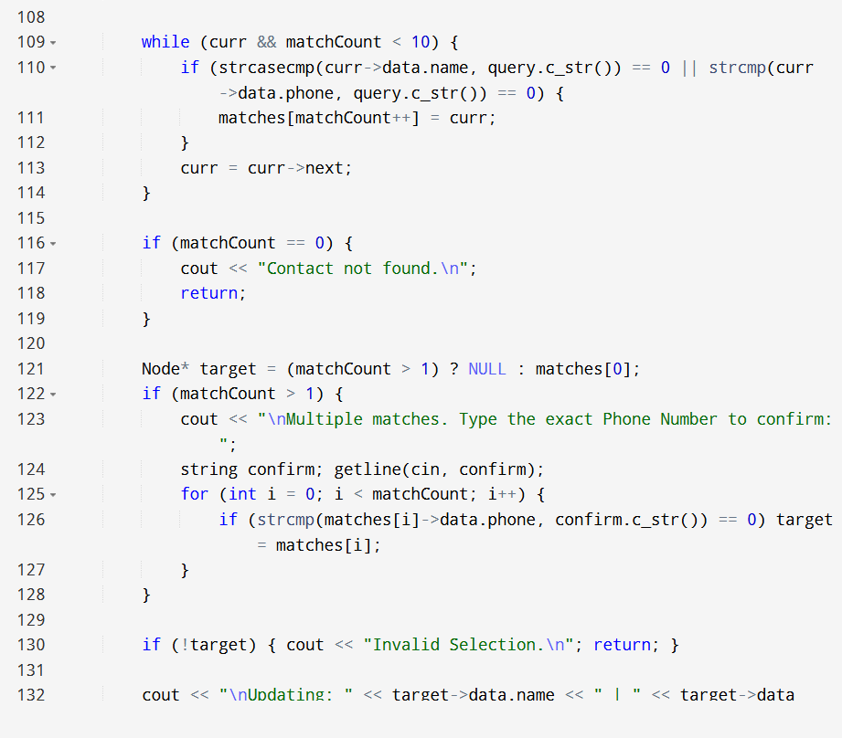
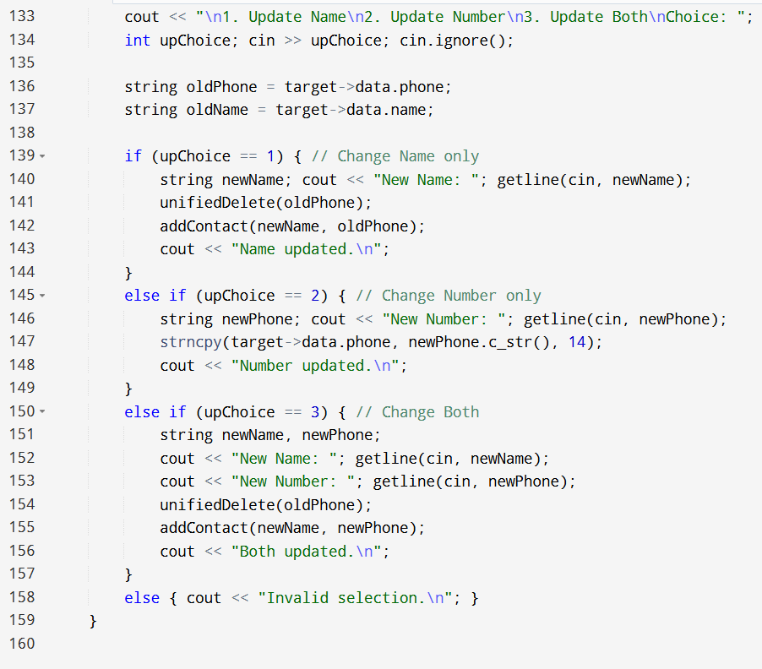

Slide 10
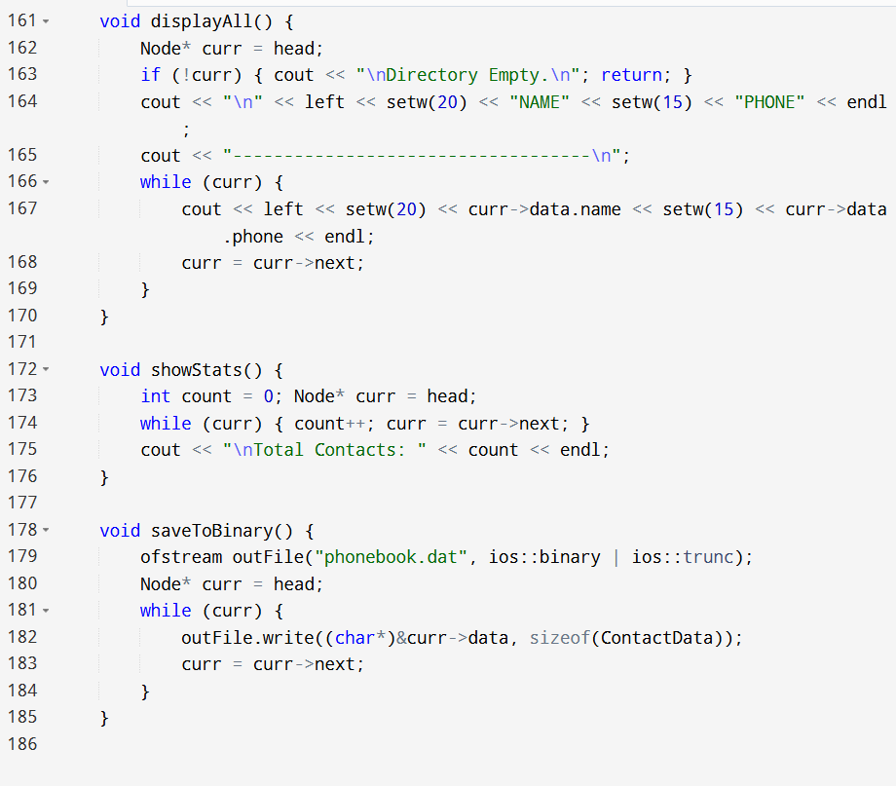
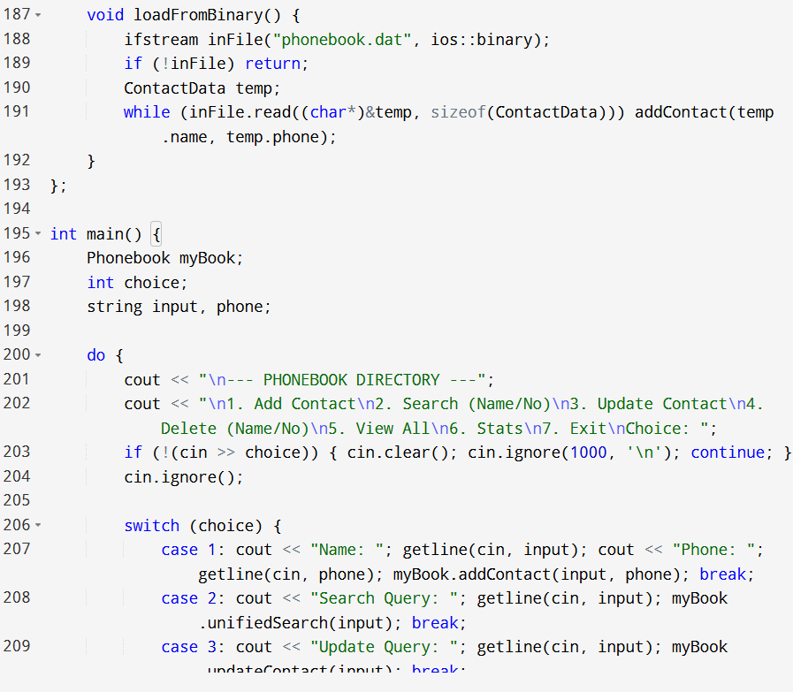

Slide 11
